Slide 1
SkyDoc™ Aerostat and Launch Systems

Slide 2
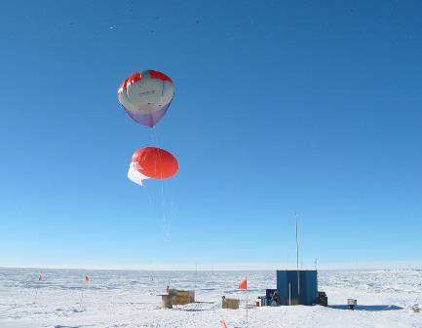
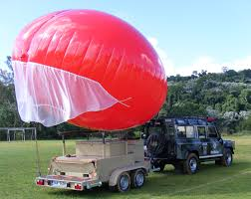
Background
Floatograph Technologies, LLC was founded in 1989.
SkyDoc™ Systems, Inc. launched in 2008 as the Aerostat Division of Floatograph Technologies, LLC.
SkyDoc™ Systems, Inc. specializes in the design integration & operations of custom surveillance & communications solutions.
The SkyDoc™ Launch and recovery trailers are the platform for the SkyDoc™ Aerostat. The trailers have been developed to fulfill the need for a variety of projects such as, Military and police requirements, atmospheric testing, monitoring of agriculture , wildlife, communications and many others.
The SkyDoc™ Aerostat is specially designed for use in a variety of environments. All types of climate whether the desert , ocean or mountainous region has unique characteristics that we have adapted our systems for.

Slide 3
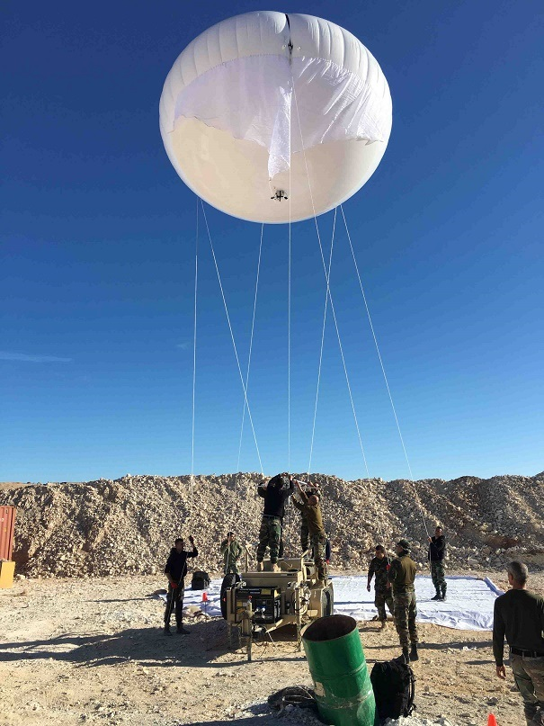
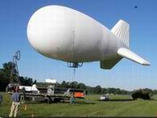
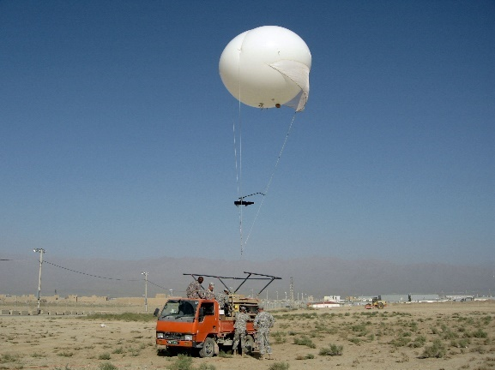
Blimp & Aerostats In the Military
Iraq with the USMC
2004 – 2006 3 sites
Aerial Communications Relay
Mobile Tethered “Balloons”
Altitude 1000 – 2000 ft.
Endurance 1 – 14 days
Payload 200 – 500 lbs
Gas Helium (non- flammable)
Examples of payloads
SIGINT surveillance
Communication relay
Surveillance Cameras
Intelligence gathering
The Evolution to Aerostats
Military planners are now focused on the small tethered and less costly aerostat that SkyDoc™ provides.

Slide 4
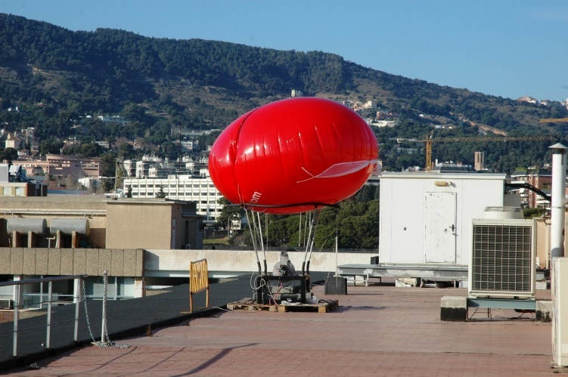
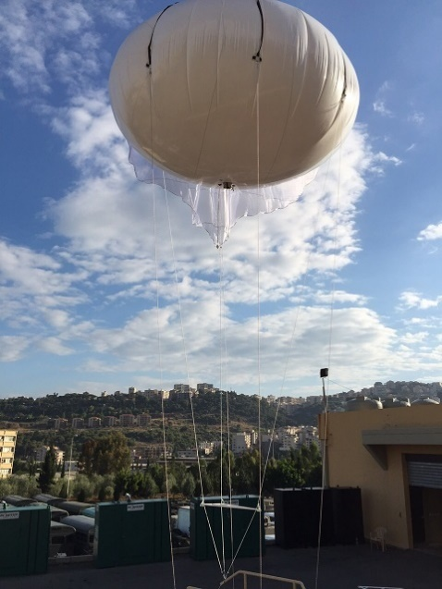

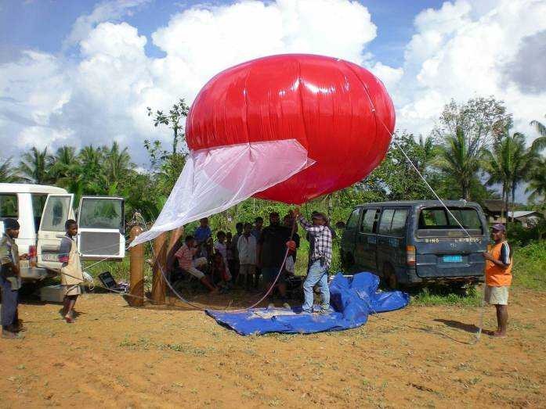
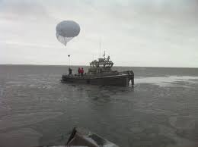
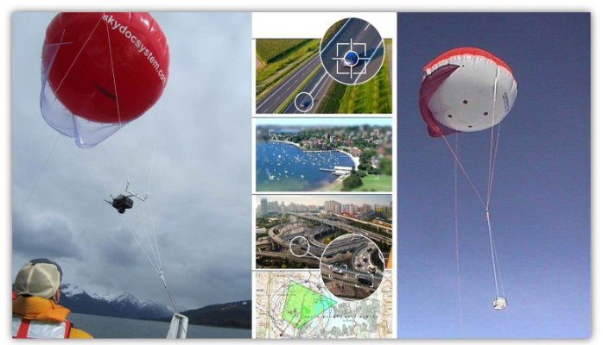
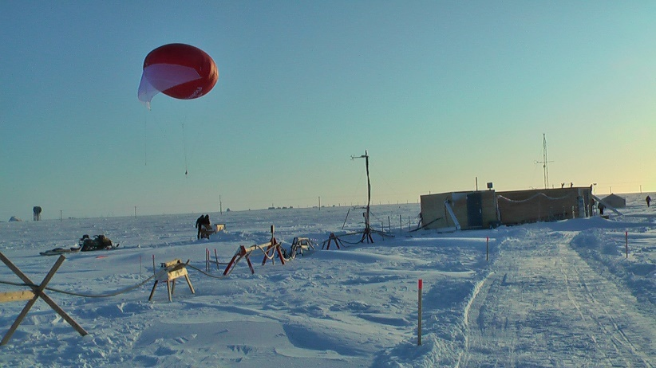
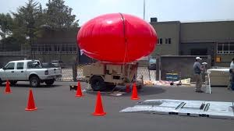
SkyDoc™ Aerostat Around the World

Slide 5
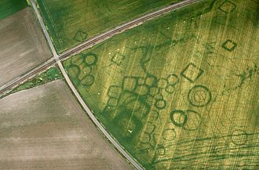
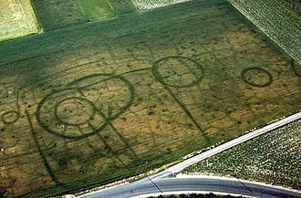
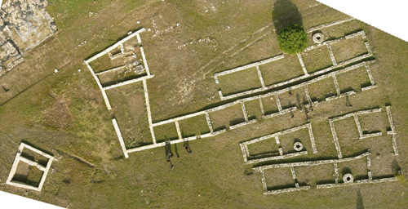
Agriculture – Archeological – Aquafarming

Slide 6
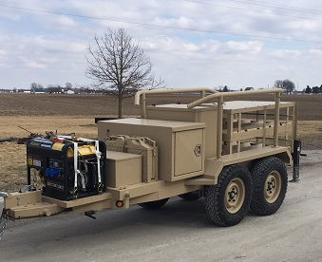
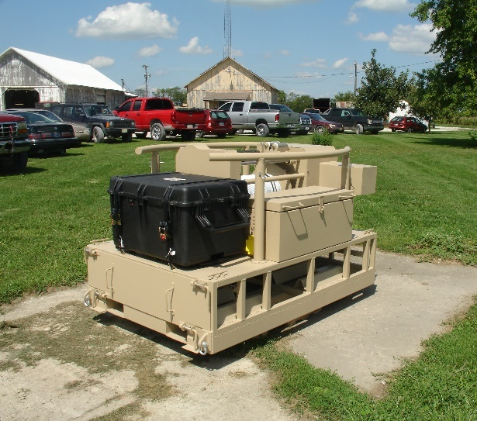
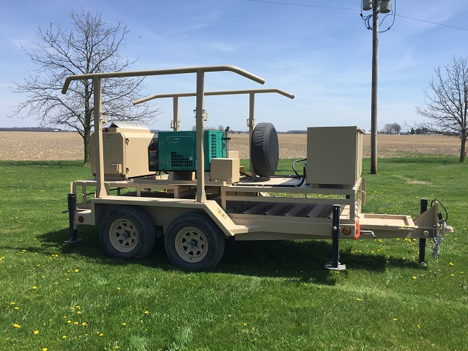
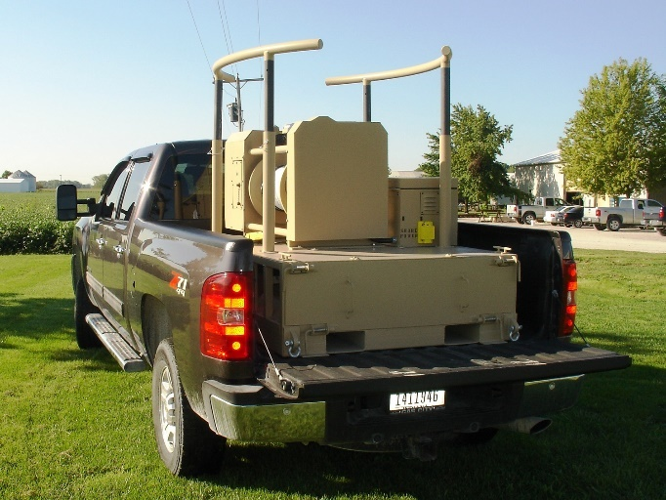
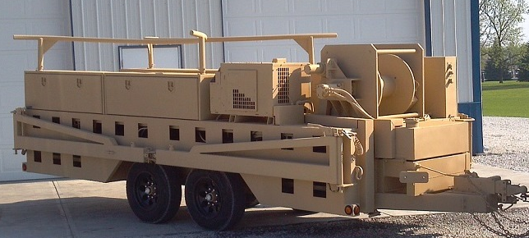
SkyDoc™ Service Trailers

Slide 7
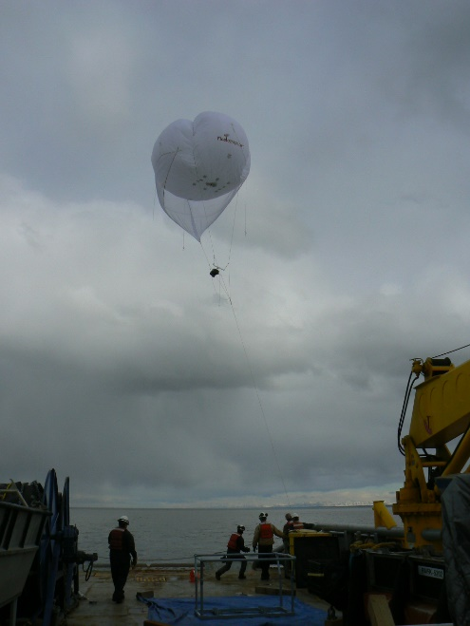
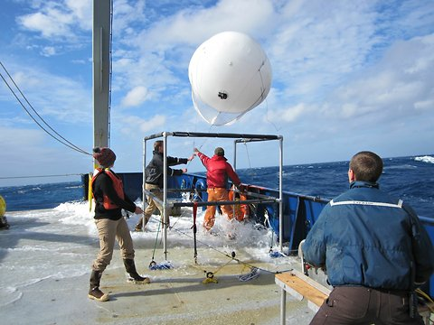
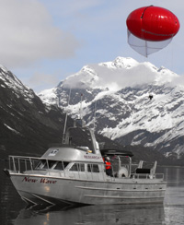
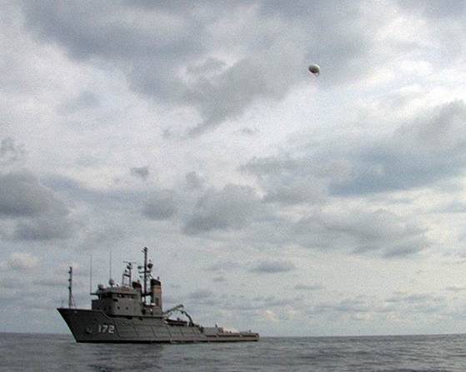
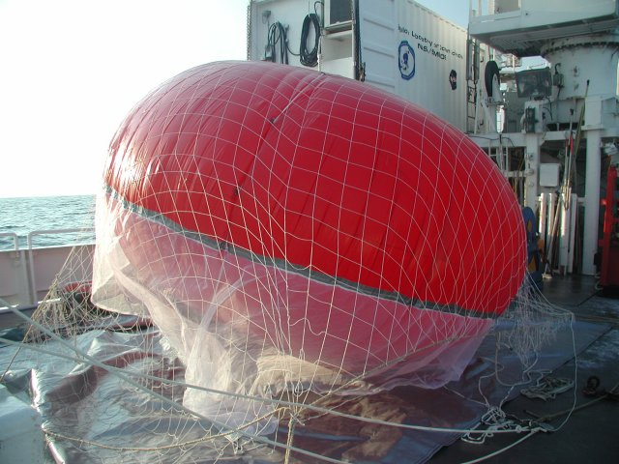
SkyDoc™ Aerostat at Sea

Slide 8


For more information please contact: charlie@skydoc.com
SkyDoc™ Systems, Inc.
Charles C. Steffen, Managing Director
$503−396−$8417

